Slide 1

Employee Attrition Analysis & Findings

Slide 2

Employee attrition Facts:
Employee attrition refers to the loss of employees through a number of circumstances, such as resignation and retirement.
One third of new hires quit their job after about six (6) months.
More than 50% of all organizations globally have difficulty retaining some of their most valued employee groups.

Slide 3
Questions which can be answered using Tableau:
Identify how specific attributes are impacting more to a data segment than others.
Analyze the correlation between various attributes and factors leading to attrition.
How to identify possible employees who can leave the company by studying historical data and doing trend analysis?
What factors and actions can company management take to retain valuable and vulnerable employees?

Slide 4
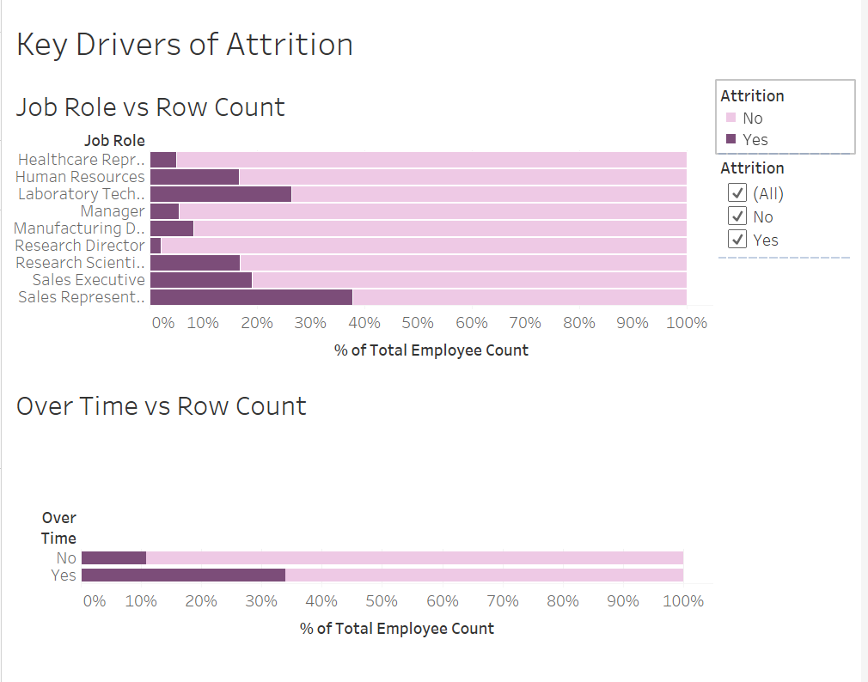
Key Drivers of Attrition

Slide 5
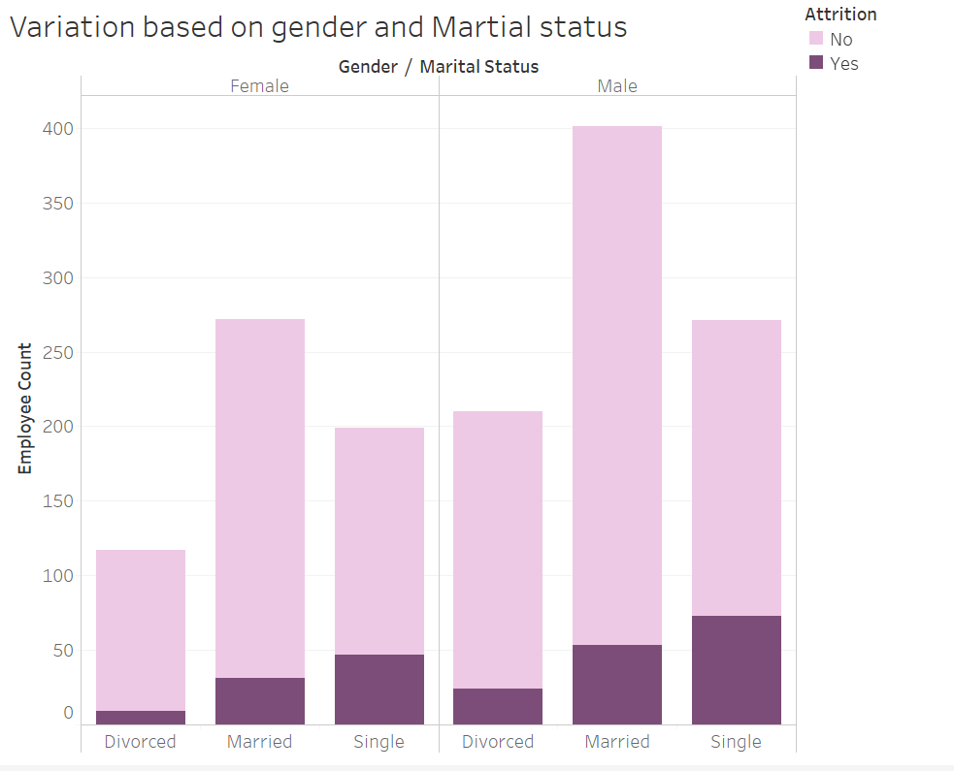

Slide 6
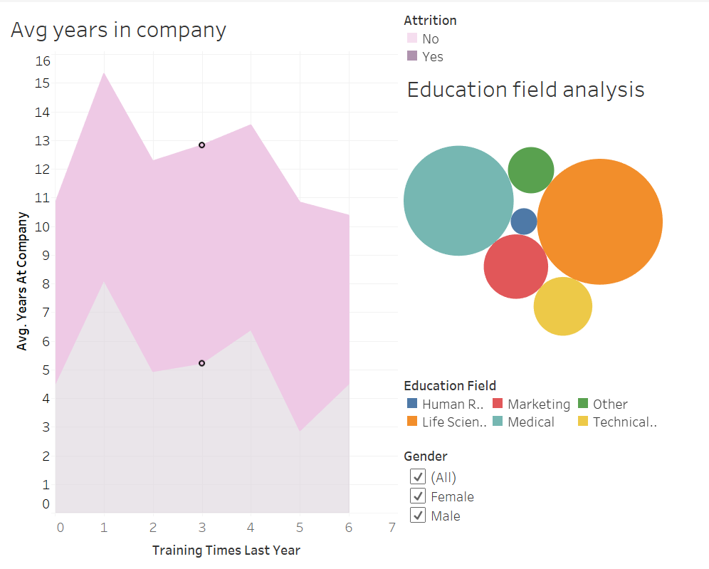

Slide 7
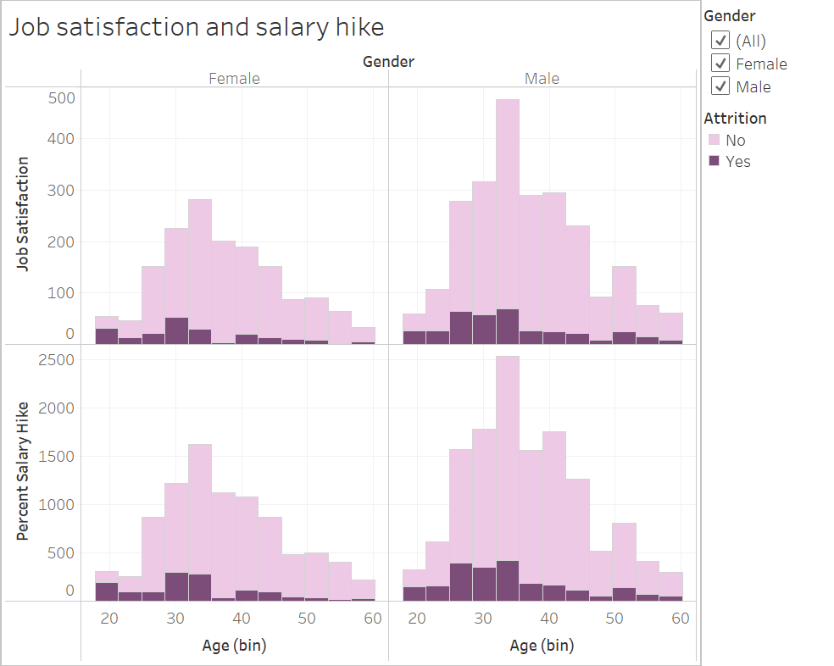

Slide 8
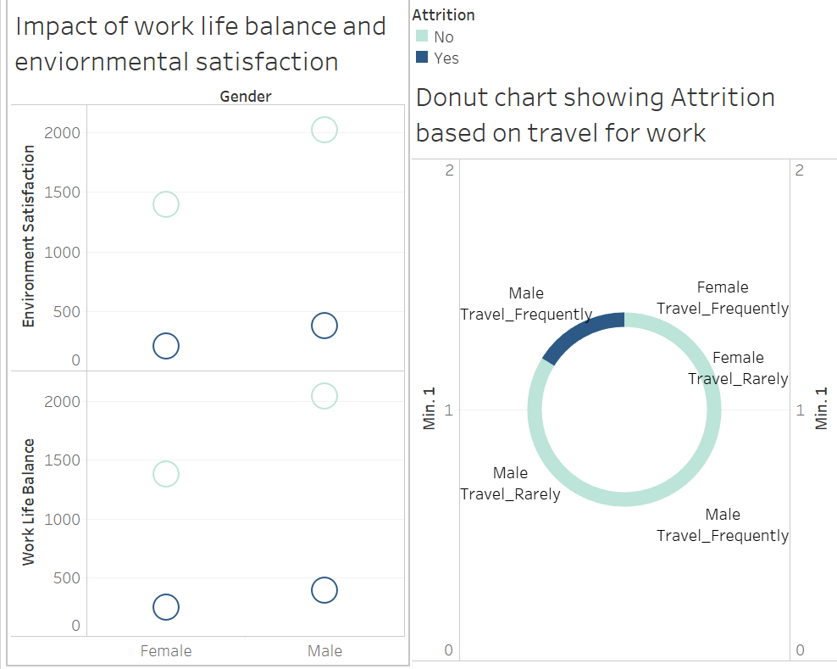

Slide 9

Conclusions:
Over time, Percentage salary hike and Job satisfaction are some important factors responsible for employee attrition.
Organization management can help people to achieve work life balance.
Present rewards and recognize achievement and make work happy.

